Slide 1
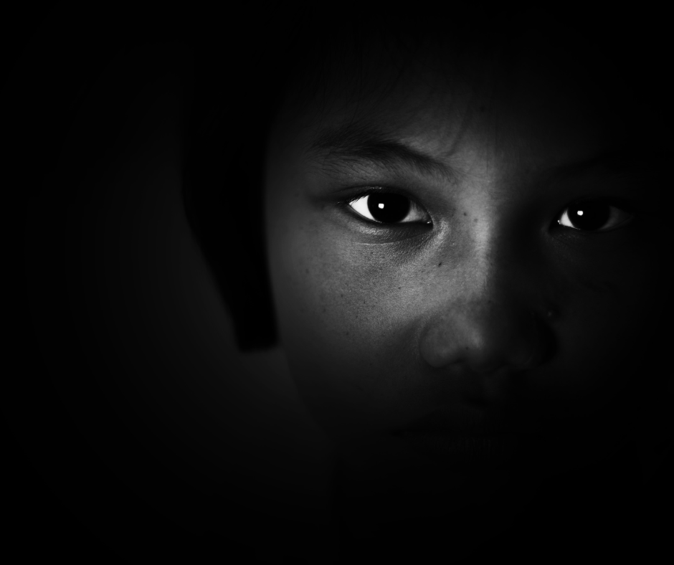

GROUP 3 (POWER SISTERS)
Presents
CHILD PROTECT
WAR AGAINST CHILD TRAFFICKING
Women Techsters

Slide 2
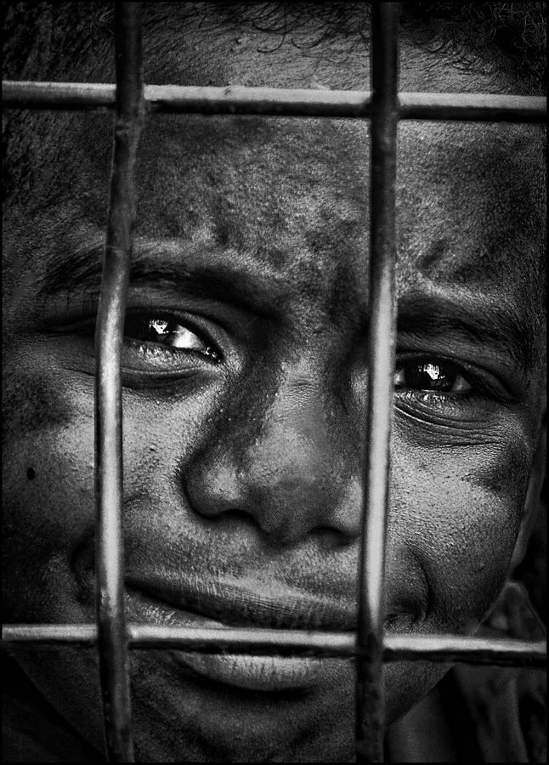
PROJECT'S OUTLINE
OUR MAIN POINTS
About Child Protect
SDG Considered
Problem
Our Plan
Our Solution Model
Team Members
Group 3 (Power Sisters) | Women Techsters 2022

Slide 3
Child protect is a platform that seeks to eradicate child trafficking and increase conviction of child trafficking cases by creating awareness to educate people about child trafficking, availability of counsellors and therapists that one can approach, a channel to connect with agencies to report trafficking cases to and a fundraising program to help victims of child trafficking.
ABOUT
CHILD PROTECT
A BRIEF DESCRIPTION
Group 3 (Power Sisters) | Women Techsters 2022

Slide 4
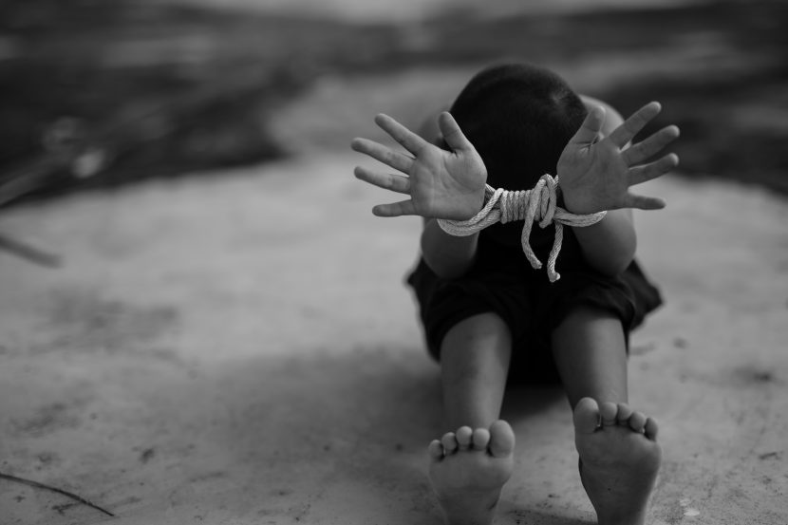

SDG CONSIDERED
GOAL 16.2
Protect children from trafficking, abuse, exploitation and violence.
Group 3 (Power Sisters) | Women Techsters 2022

Slide 5
Child trafficking is the exploitation of children primarily for forced labor and sexual exploitation.
Child trafficking thrives in times of conflict and crisis, and due to the global pandemic since 2020 child trafficking has been on the rise.
75% of human trafficking victims in west Africa is children and 80% of those victims are trafficked for forced labor in hazardous forms of work
As a result of child trafficking the number of school drop outs , children lives risked and children robbed off their childhood is on the high
Due to lack of enough knowledge sometimes children are being sold by family members who are moved by false promises of a “better” life.
PROBLEM
Group 3 (Power Sisters) | Women Techsters 2022

Slide 6
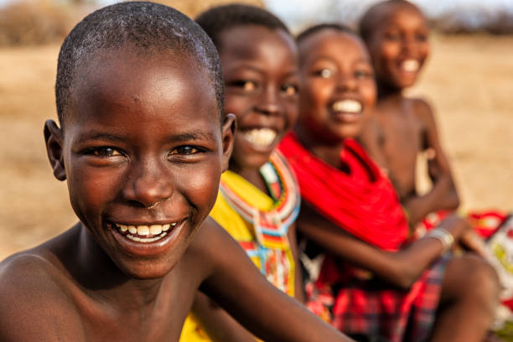

THE BIG DREAM
OUR PLAN
Creating awareness by educating children, relatives and the society about child trafficking and the dangers exposed to children who are trafficked
Create a donation platform where we can raise funds to help victims of child trafficking
Having hotline numbers where we connect victims with counsellors therapists, and anti-trafficking agencies to talk about abuse or report cases
Group 3 (Power Sisters) | Women Techsters 2022

Slide 7




OUR SOLUTION MODEL
WHAT WE WANT TO ACHIEVE
Educate more people about child trafficking and how to fight it until we see a significant increase in conviction of child trafficking cases
Donation program that will help educate victims. Provide basic needs, and bring child victims back with their families
Provide a channel to connect victims and other people to counsellors, therapists, and agencies for counselling, reporting and for conviction of child trafficking cases
Eradicate child labor and exploitation
Group 3 (Power Sisters) | Women Techsters 2022

Slide 8
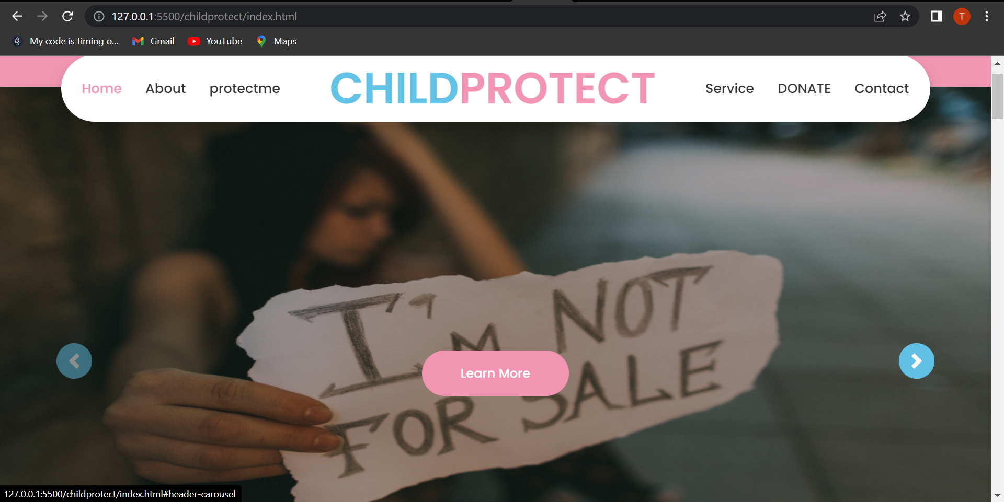
PLATFORM'S LANDING PAGE
(A SNIPPET)

Slide 9

Team Members
Shalom Muyera - muyerashalom26@gmail.com
Patricia Atumonyego -patriciaatumonyego128@gmail.com
Lourdes Wairimu Nganga - lourdeswairimu@gmail.com
Naomi Thomas - thoamsnaomi89@gmail.com
Kausar Olamide Abdulkareem - kausarabdulkareem@gmail.com
Omoseke Halimah Salami - omosekesalami@gmail.com
Fadila Falalu - faddalfadila230@gmail.com
Esther Gathoni - esternjuguna@gmail.com
Basirah Kehinde - kennyb143524@gmail.com
Kosisochukwu Melidem - Meli55kosi@gmail.com
Dorcas Onigbinde - dorcasoluwapelumi18@gmail.com
Ejiowhor Ijeoma - ijeomaejiowhor2@gmail.com
Tricia Ojiaka - ojiakatricia@gmail.com
Pascaline Ezike - ezikepascaline@gmail.com
Ruth Akagwu - ruthakagwu@outlook.com
Njehwi Zaraphat Haruna - zaraphathnz@gmail.com
Chinaza Jessica - mbahchinazajessica@gmail.com
Mozia Precious - chibundumozia@gmail.com
Prudence Njema - statowanjiru@gmail.com
Mercy Ezeh - mercychieze4@gmail.com
Team Leader
Toye Omolara
toyeomolara@gmail.com
)
Assistant team leader
Bridget Bernard
bernardbridgit@gmail.com
)
)
)
Group 3 (Power Sisters) | Women Techsters 2022

Slide 10
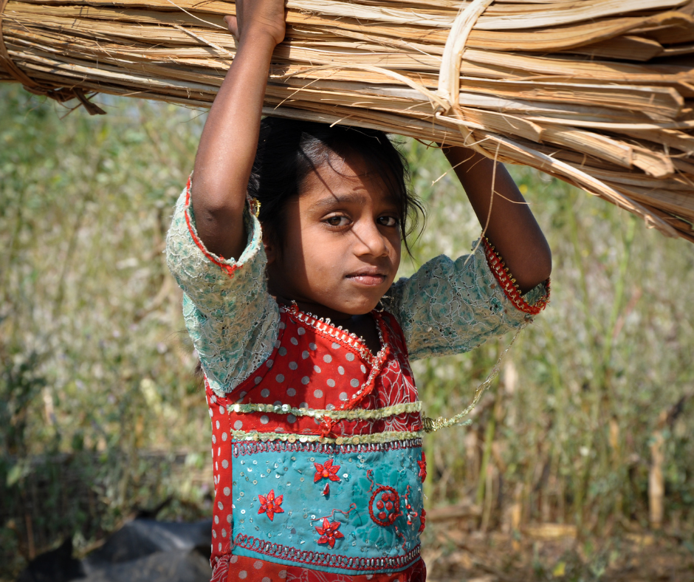
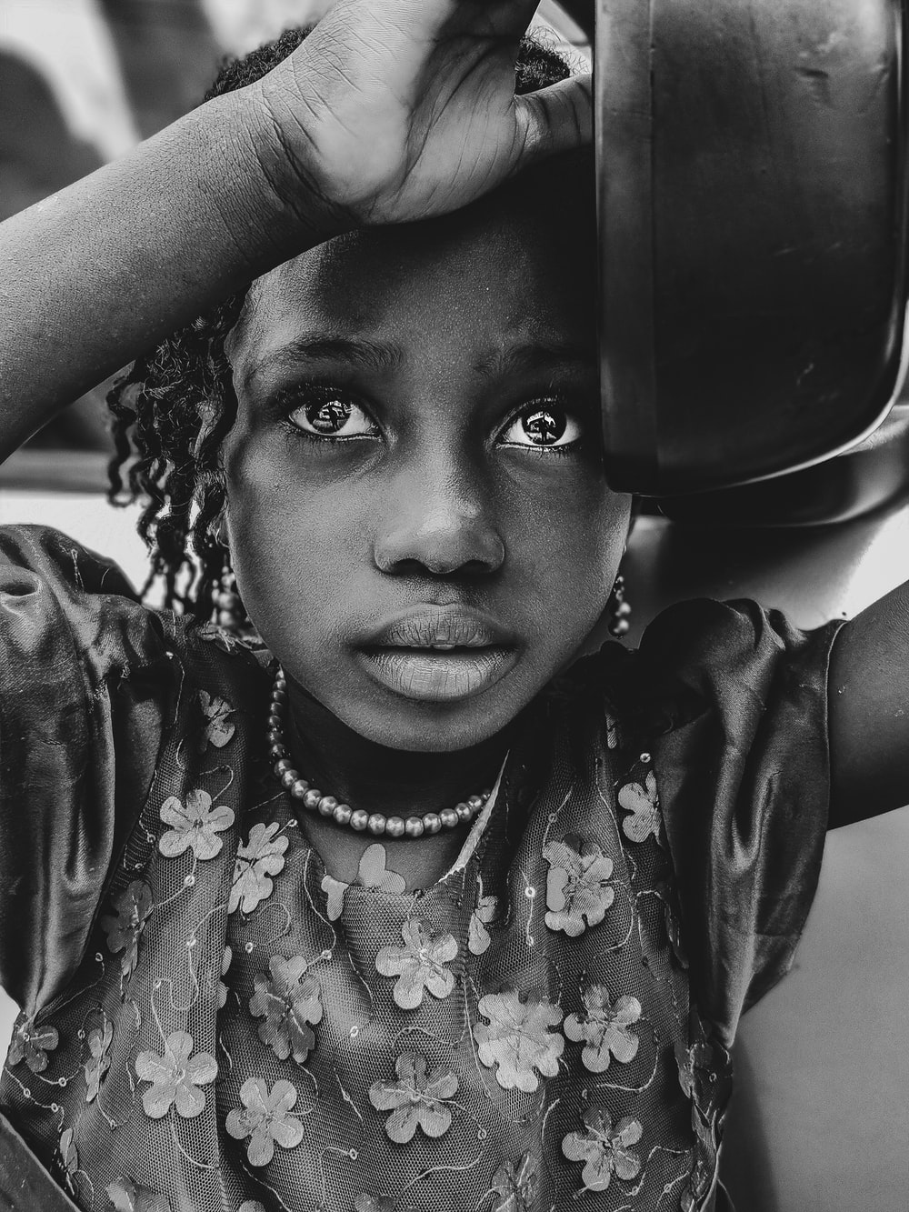
CHILD
PROTECT
WAR AGAINST CHILD TRAFFICKING
Group 3 (Power Sisters) | Women Techsters 2022

Slide 11
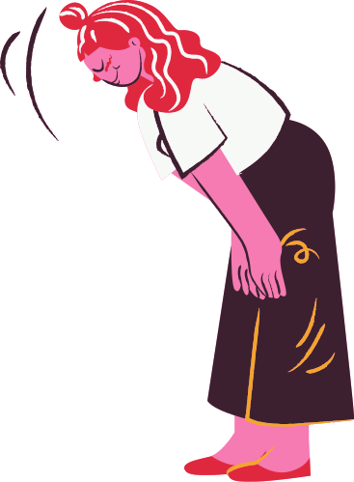
THANK YOU!
THANK YOU FOR THE OPPORTUNITY, WOMEN TECHSTERS!!!
Group 3 (Power Sisters) | Women Techsters 2022

